Slide 1
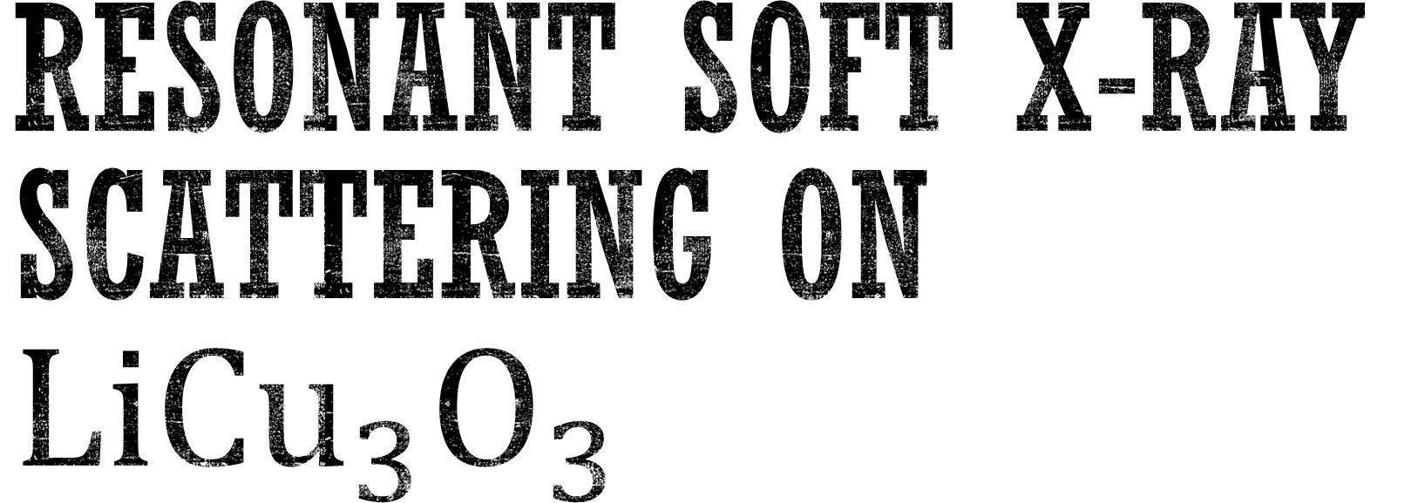
Resonant Soft X-ray SCAttering on $LiCu_{3}O_{3}$

Slide 2
outline
Introduction
Presenting raw data from the experiment
Fitting the data for each energy
Unexpected feature in the data
Exctracting physical quantities form the data
Kramers-Kronig Analysis
Total Electron Yield
Magnetic Dichorism
Optical Conductivity

Slide 3
I. Introduction:
Material characterization
Theoretical Introduction
Experimental geometry

Slide 4

$$LiCu_{3}O_{3}$$
Trilayers of rocksalt Cu(II)O are sandwiched between planes of Cu(I)
The Lithium randomly substitutes the Cu(II) ions
Lattice: tetragonal crystal structure (P4/mmm, a = 2.81 A ̊, c = 8.90 A ̊)

Slide 5
Theoretical introduction

Slide 6
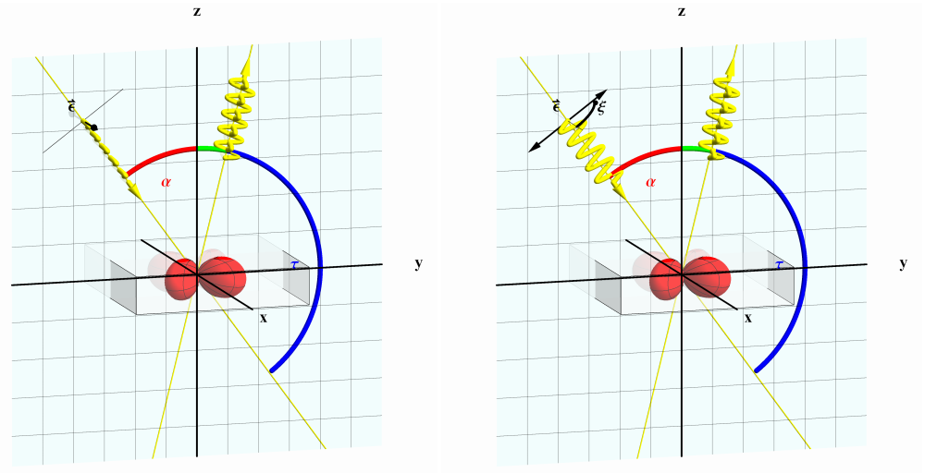
Experimental geometry
LV
LH
The polarisation geometry was chosen the same as in Moser [5], thus the scattering plane lies in the yz plane (as shown in the figure for in-plane (LH) and out of plane (LV) polarization).

Slide 7
II. Presenting raw data from the experiment:
Raw data
Normalizing raw data
Quick analysis

Slide 8
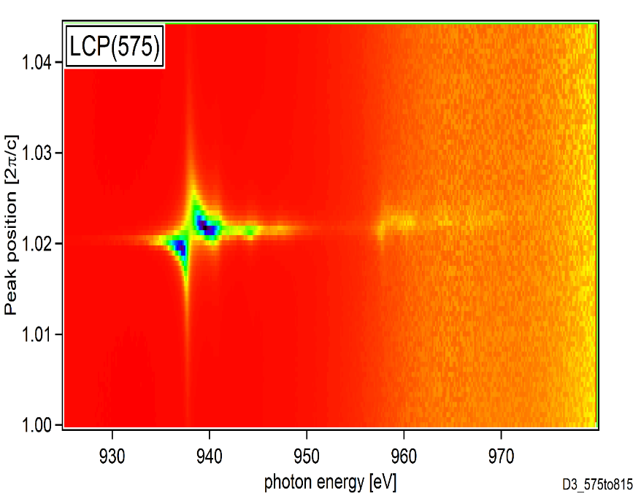
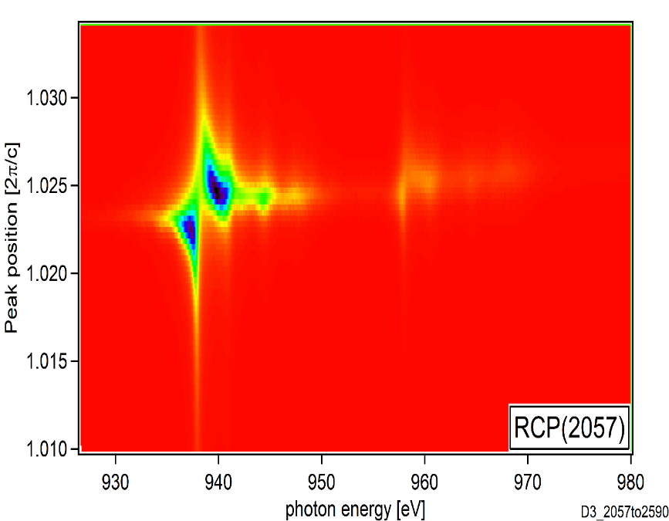
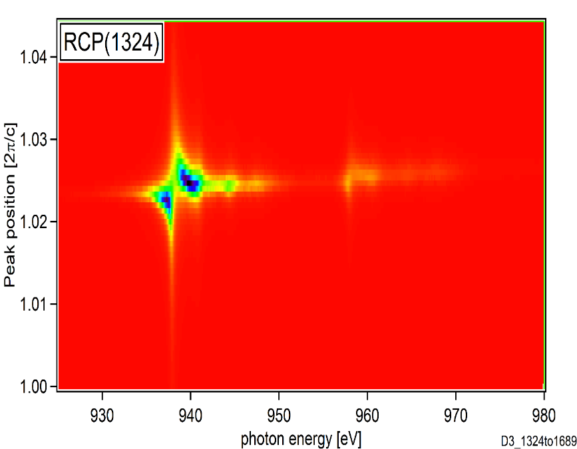
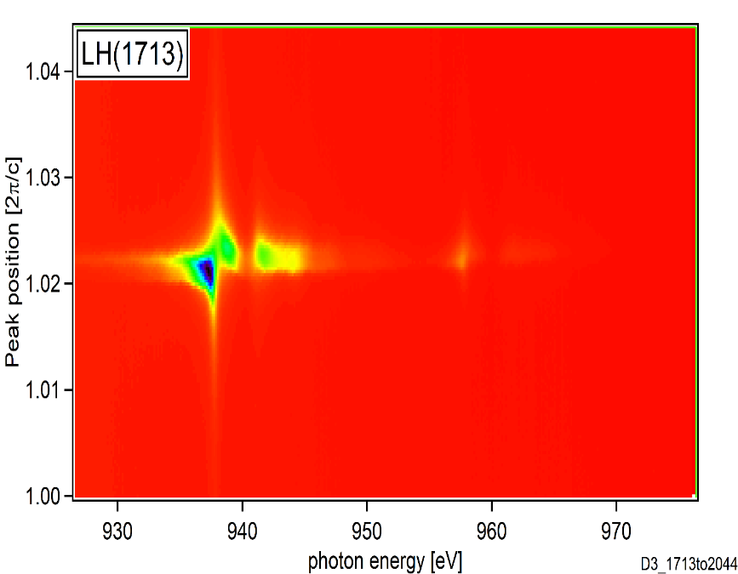
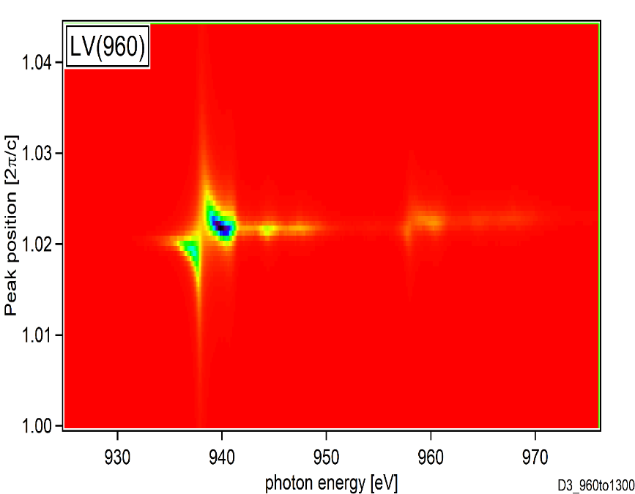
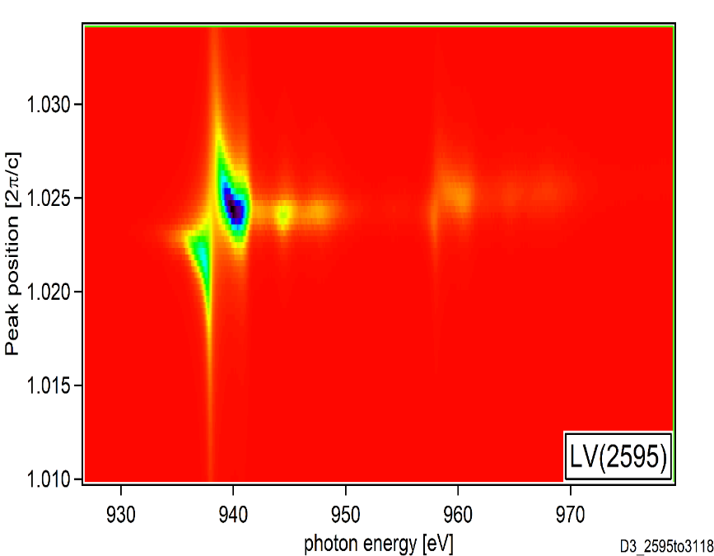
RAW rsxs data

Slide 9
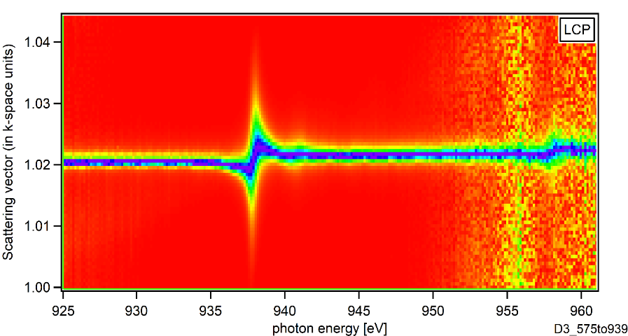
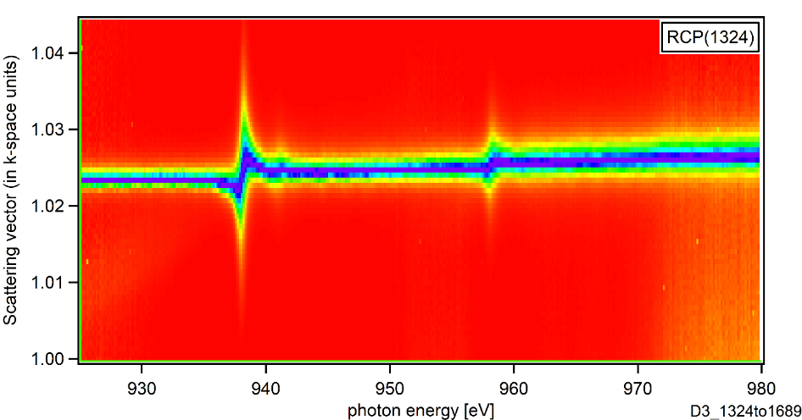
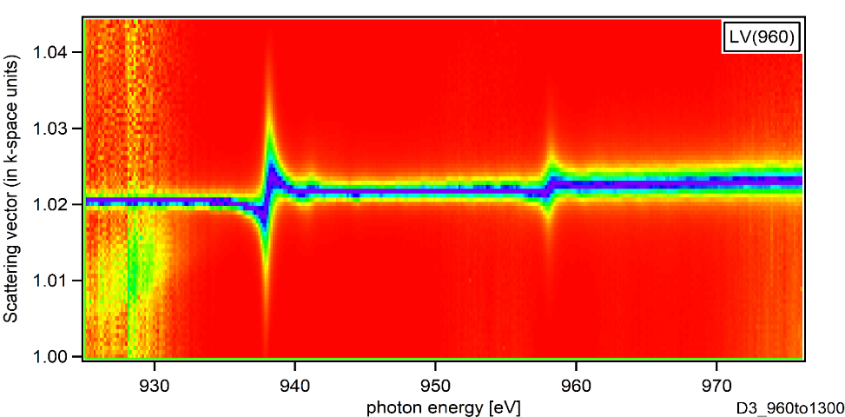
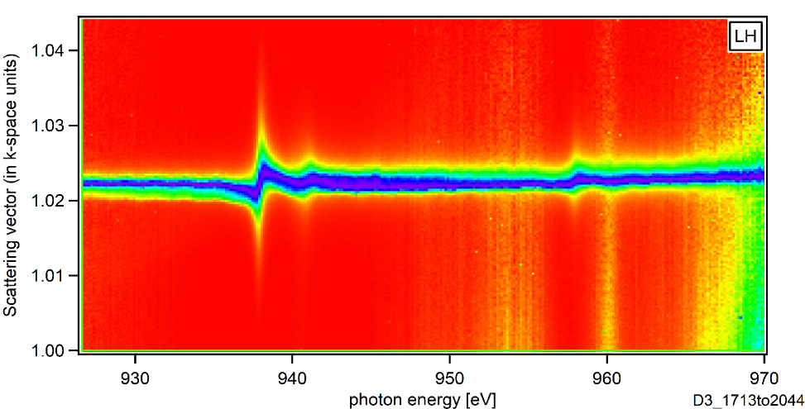
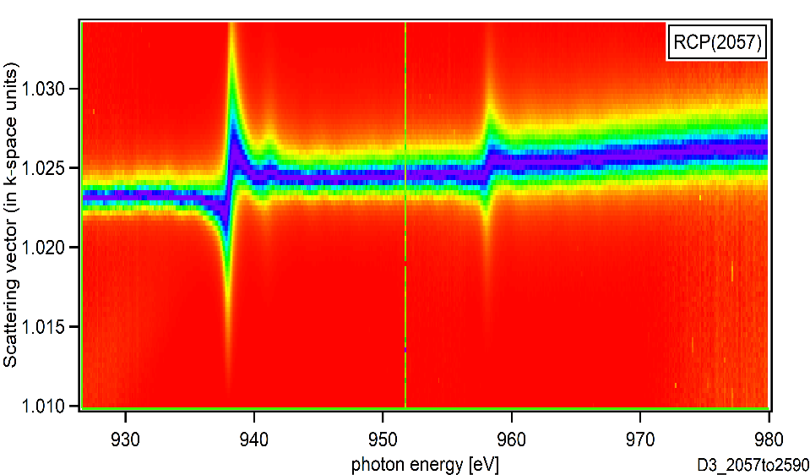
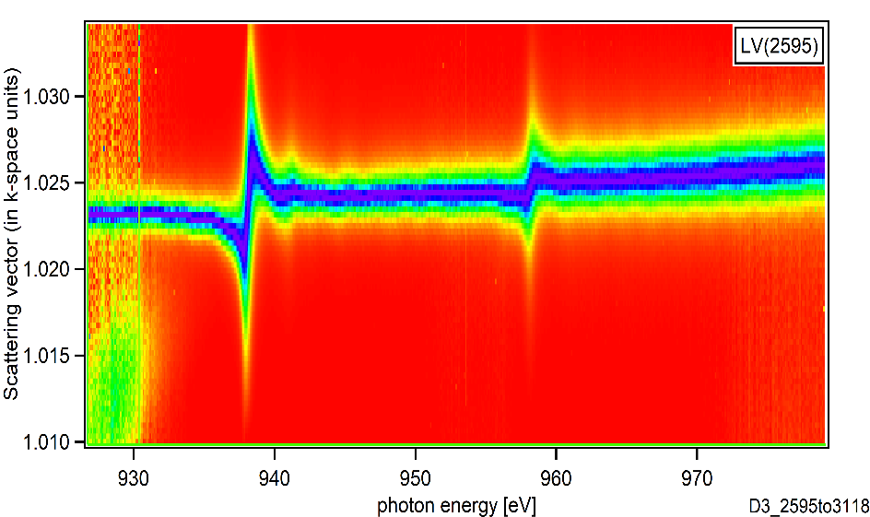

RSXS results – normalized by $\frac{−I_{min}(θ)}{I_{max}\left(θ\right)−I_{min}(θ)}$

Slide 10
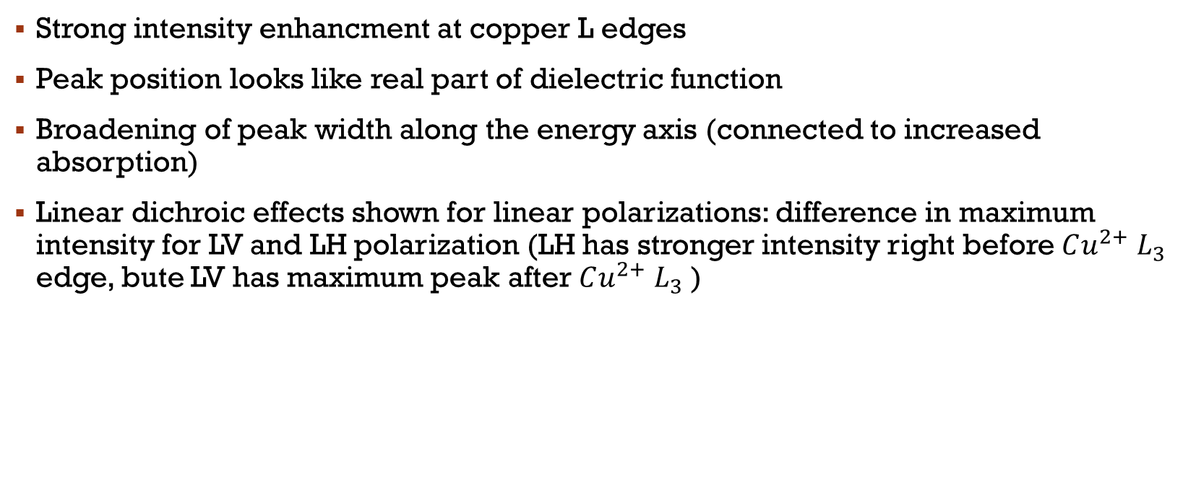
Raw data analysis
Strong intensity enhancment at copper L edges
Peak position looks like real part of dielectric function
Broadening of peak width along the energy axis (connected to increased absorption)
Linear dichroic effects shown for linear polarizations: difference in maximum intensity for LV and LH polarization (LH has stronger intensity right before $Cu^{2+} L_{3}$ edge, bute LV has maximum peak after $Cu^{2+} L_{3}$ )

Slide 11
III. Fitting raw data for each energy:
Comparing gaussian and lorentzian fit
Fitting the experimental data

Slide 12
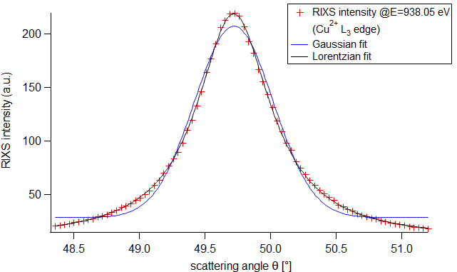
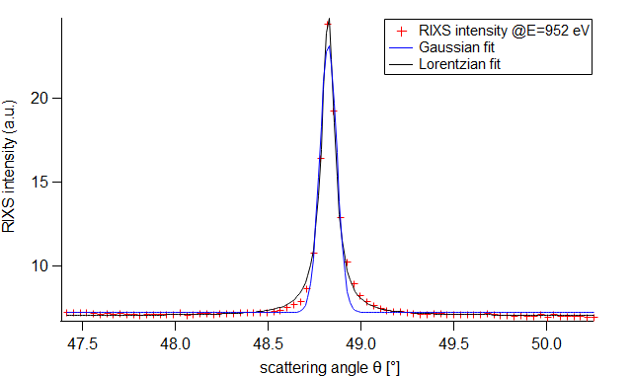
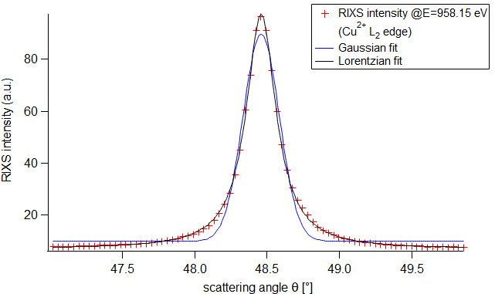
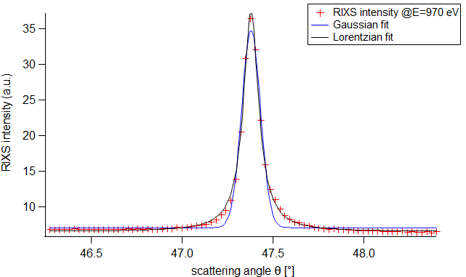
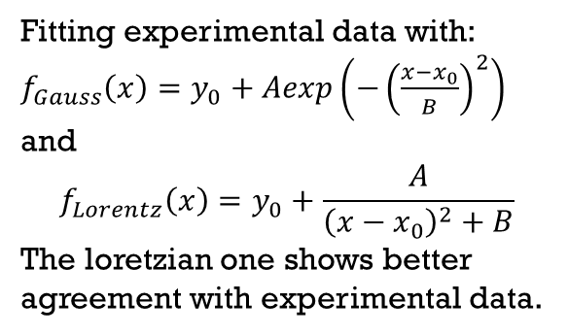
Fitting raw data
Fitted raw data for LV(960) polaraization
Fitting experimental data with:
$f_{Gauss}\left(x\right)=y_{0}+Aexp\left({−\left(\frac{x−x_{0}}{B}\right)}^{2}\right)$
and
$$f_{Lorentz}\left(x\right)=y_{0}+\frac{A}{{\left(x−x_{0}\right)}^{2}+B}$$
The loretzian one shows better agreement with experimental data.

Slide 13
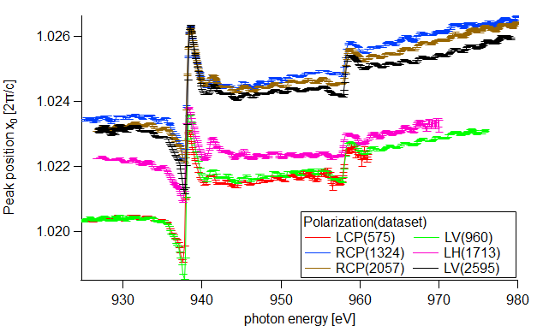
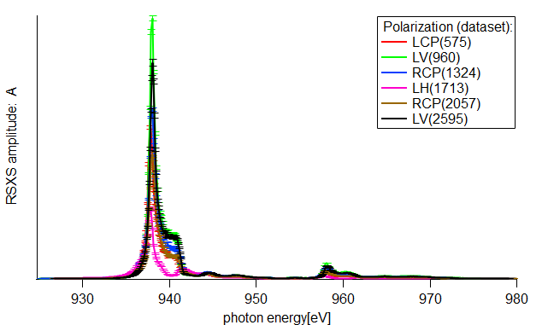
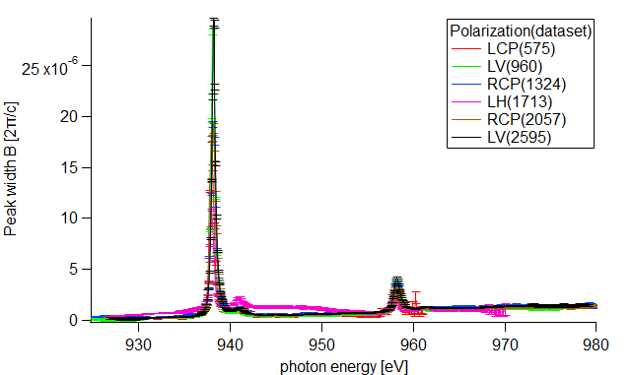
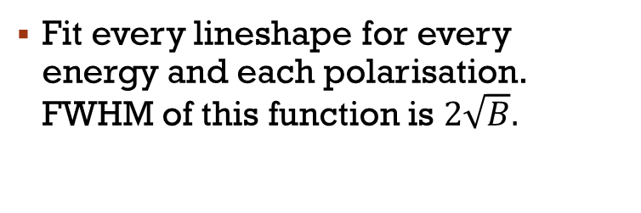
Fitting raw data
Fit every lineshape for every energy and each polarisation. FWHM of this function is $2\sqrt{B}.$

Slide 14
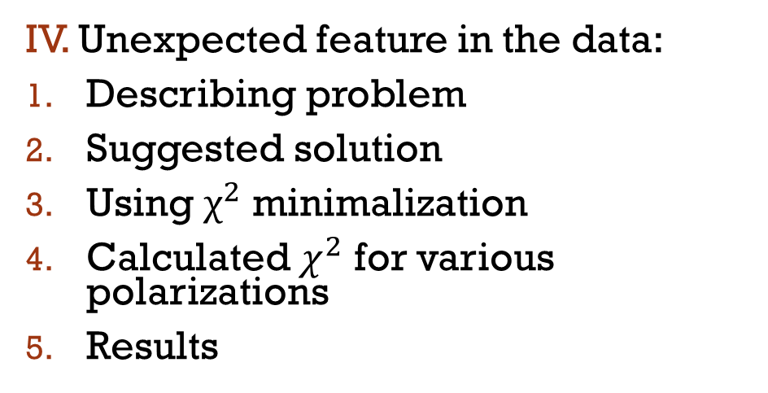
IV. Unexpected feature in the data:
Describing problem
Suggested solution
Using $χ^{2}$ minimalization
Calculated $χ^{2}$ for various polarizations
Results

Slide 15
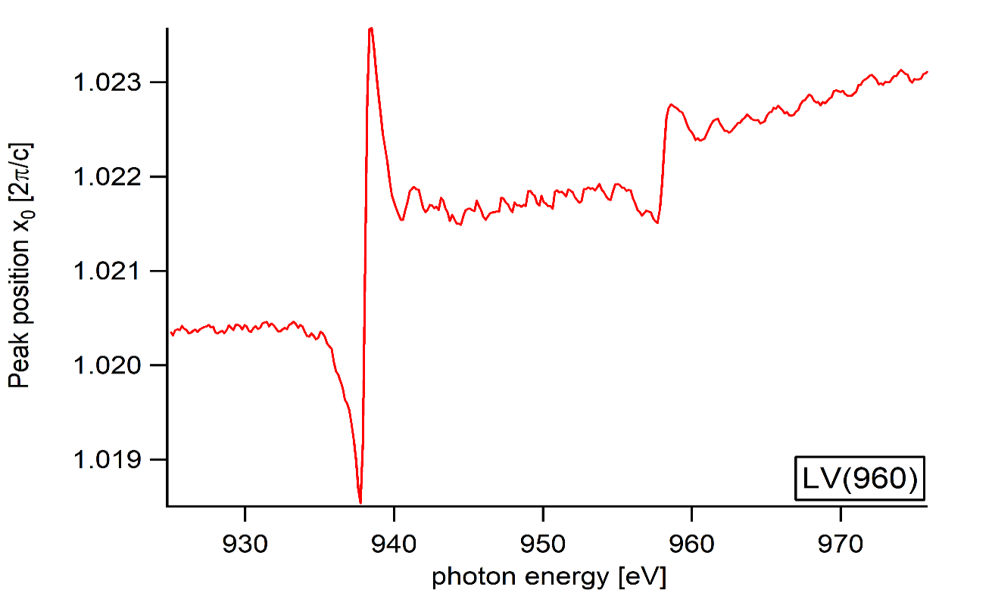
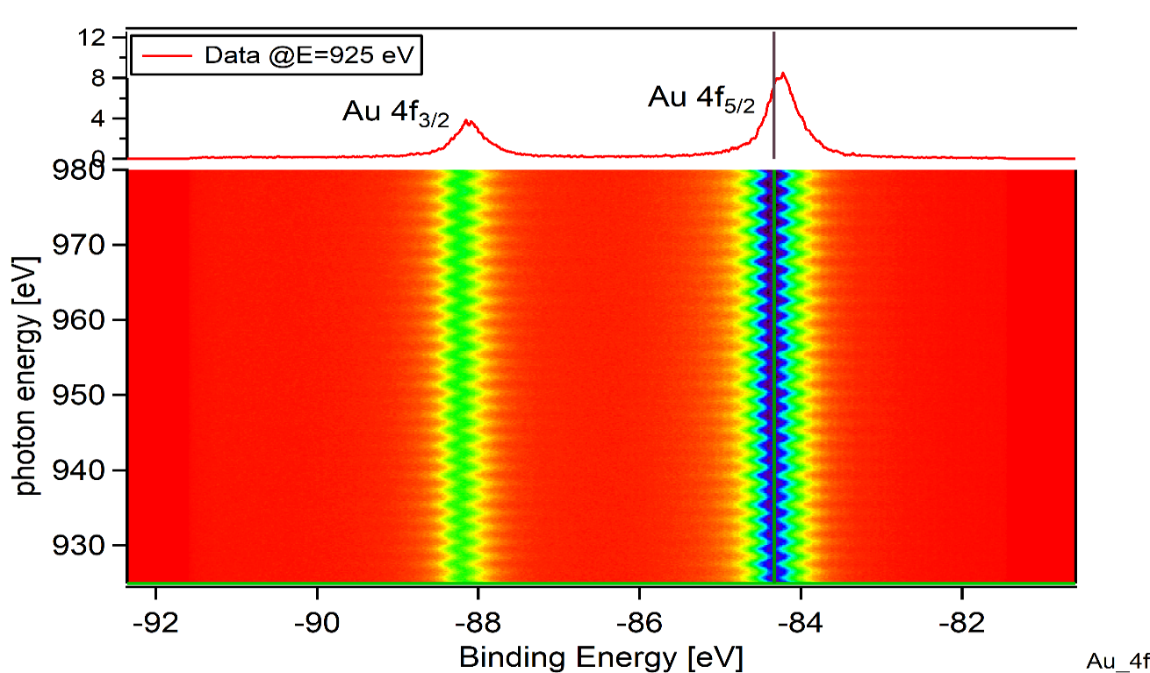
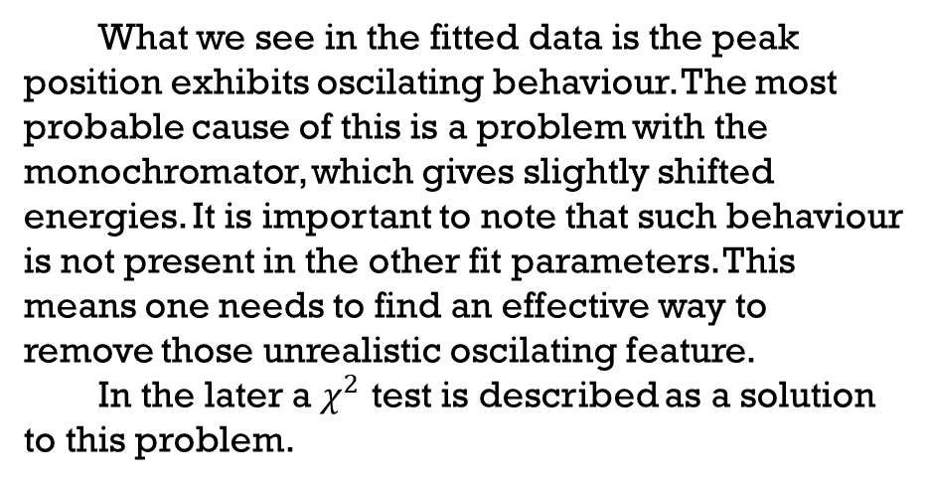
Describing problem
What we see in the fitted data is the peak position exhibits oscilating behaviour. The most probable cause of this is a problem with the monochromator, which gives slightly shifted energies. It is important to note that such behaviour is not present in the other fit parameters. This means one needs to find an effective way to remove those unrealistic oscilating feature.
In the later a $χ^{2}$ test is described as a solution to this problem.

Slide 16
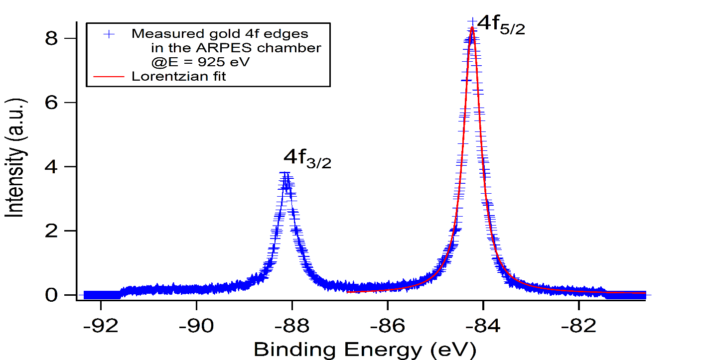
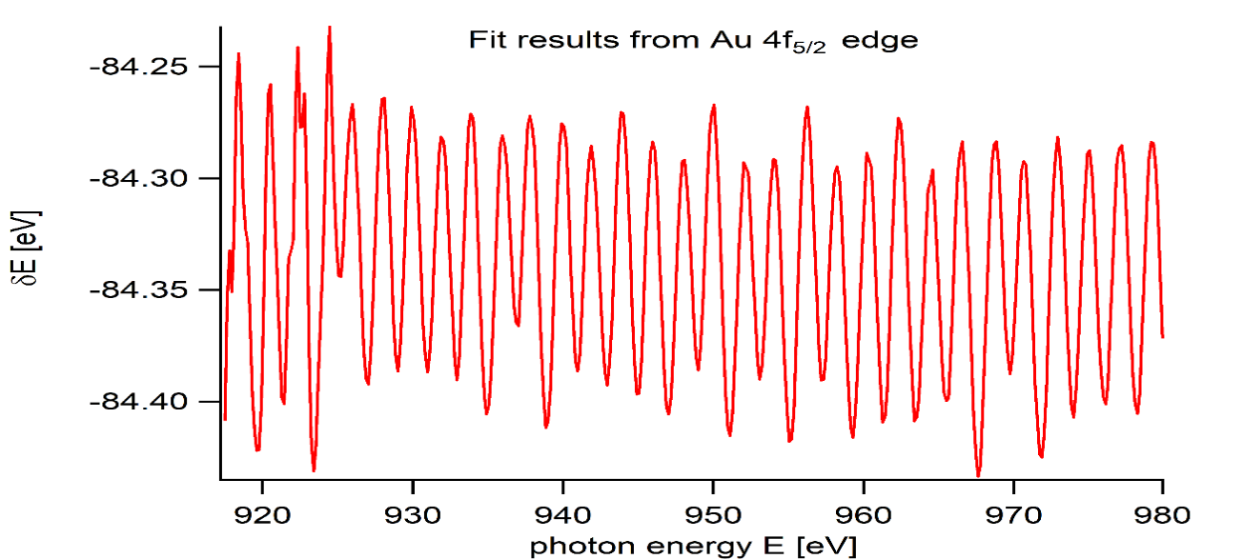
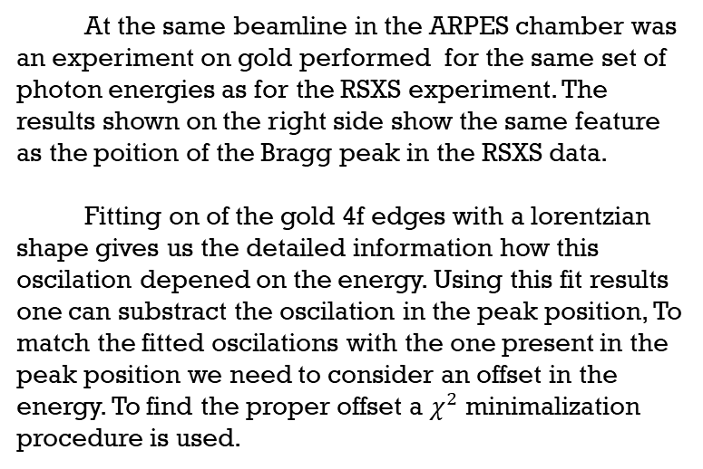
Solution
At the same beamline in the ARPES chamber was an experiment on gold performed for the same set of photon energies as for the RSXS experiment. The results shown on the right side show the same feature as the poition of the Bragg peak in the RSXS data.
Fitting on of the gold 4f edges with a lorentzian shape gives us the detailed information how this oscilation depened on the energy. Using this fit results one can substract the oscilation in the peak position, To match the fitted oscilations with the one present in the peak position we need to consider an offset in the energy. To find the proper offset a $χ^{2}$ minimalization procedure is used.

Slide 17
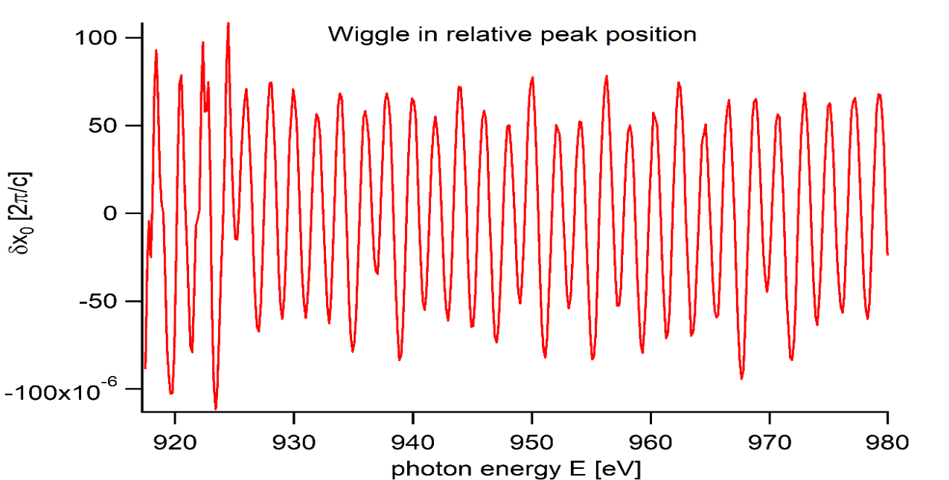
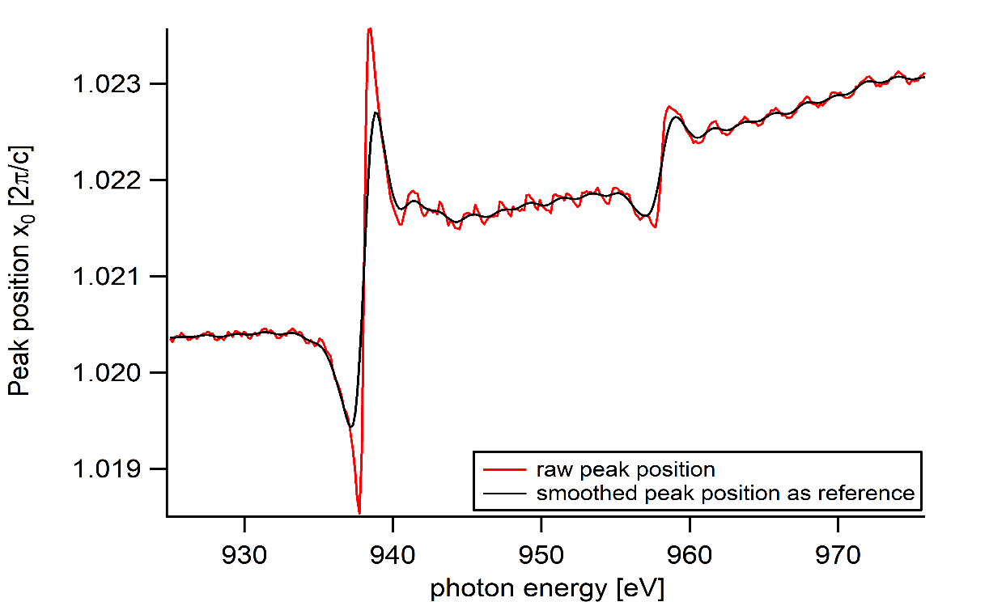
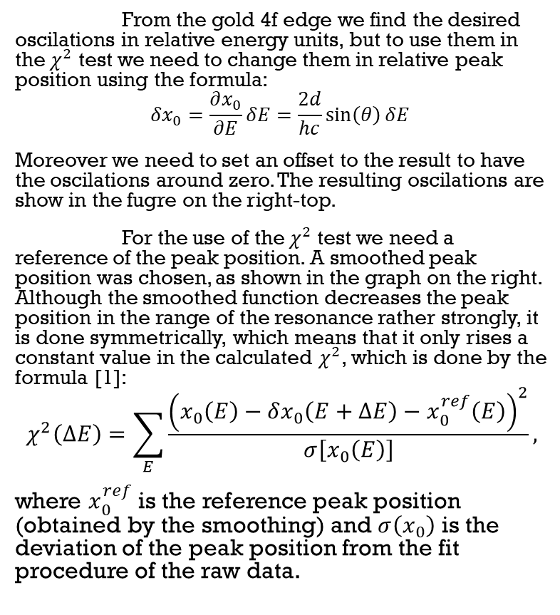

using $χ^{2}$ minimalization
From the gold 4f edge we find the desired oscilations in relative energy units, but to use them in the $χ^{2}$ test we need to change them in relative peak position using the formula:
$$δx_{0}=\frac{∂x_{0}}{∂E}δE=\frac{2d}{hc}\sin\left(θ\right)δE$$
Moreover we need to set an offset to the result to have the oscilations around zero. The resulting oscilations are show in the fugre on the right-top.
For the use of the $χ^{2}$ test we need a reference of the peak position. A smoothed peak position was chosen, as shown in the graph on the right. Although the smoothed function decreases the peak position in the range of the resonance rather strongly, it is done symmetrically, which means that it only rises a constant value in the calculated $χ^{2}$, which is done by the formula [1]:
$$χ^{2}\left(ΔE\right)=\sum_{E}{\frac{{\left(x_{0}\left(E\right)−δx_{0}\left(E+ΔE\right)−x_{0}^{ref}\left(E\right)\right)}^{2}}{σ\left[x_{0}\left(E\right)\right]},}$$
where $x_{0}^{ref}$ is the reference peak position (obtained by the smoothing) and $σ\left(x_{0}\right)$ is the deviation of the peak position from the fit procedure of the raw data.

Slide 18
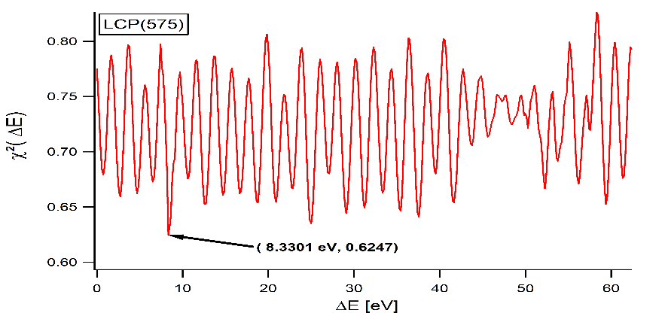
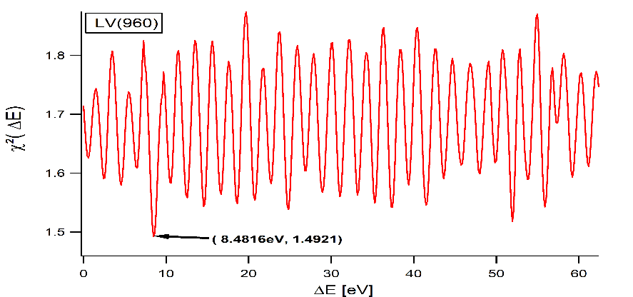
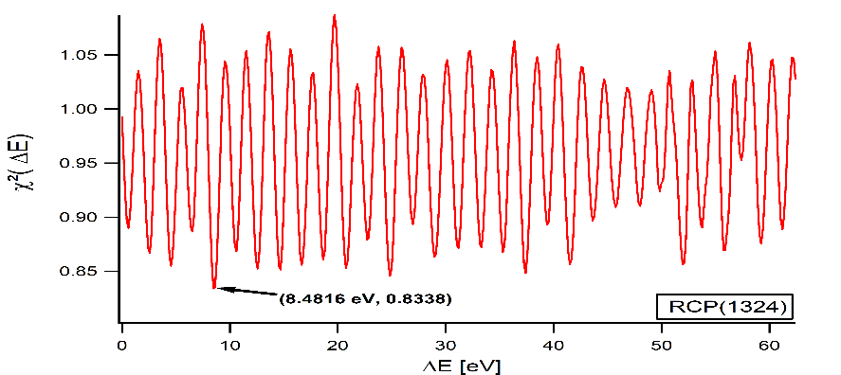
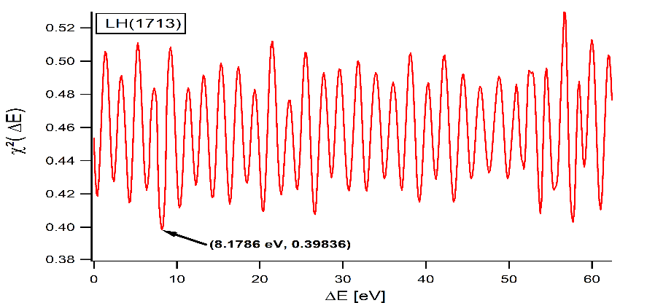
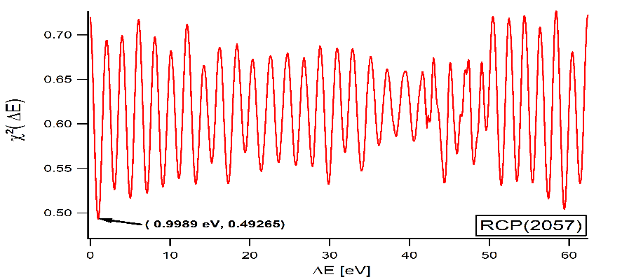
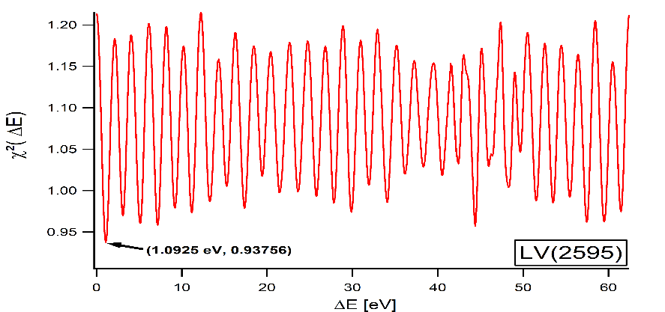
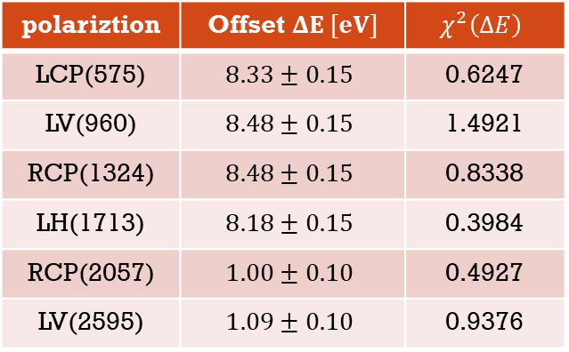
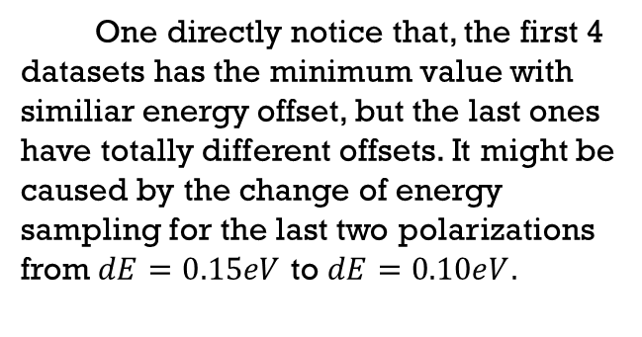
Calculated $χ^{2}$ for various polarizations
One directly notice that, the first 4 datasets has the minimum value with similiar energy offset, but the last ones have totally different offsets. It might be caused by the change of energy sampling for the last two polarizations from $dE=0.15eV$ to $dE=0.10eV.$
polariztion | Offset $ΔE [eV]$ | $$χ^{2}\left(ΔE\right)$$
LCP(575) | $$8.33±0.15$$ | 0.6247
LV(960) | $$8.48±0.15$$ | 1.4921
RCP(1324) | $$8.48±0.15$$ | 0.8338
LH(1713) | $$8.18±0.15$$ | 0.3984
RCP(2057) | $$1.00±0.10$$ | 0.4927
LV(2595) | $$1.09±0.10$$ | 0.9376

Slide 19
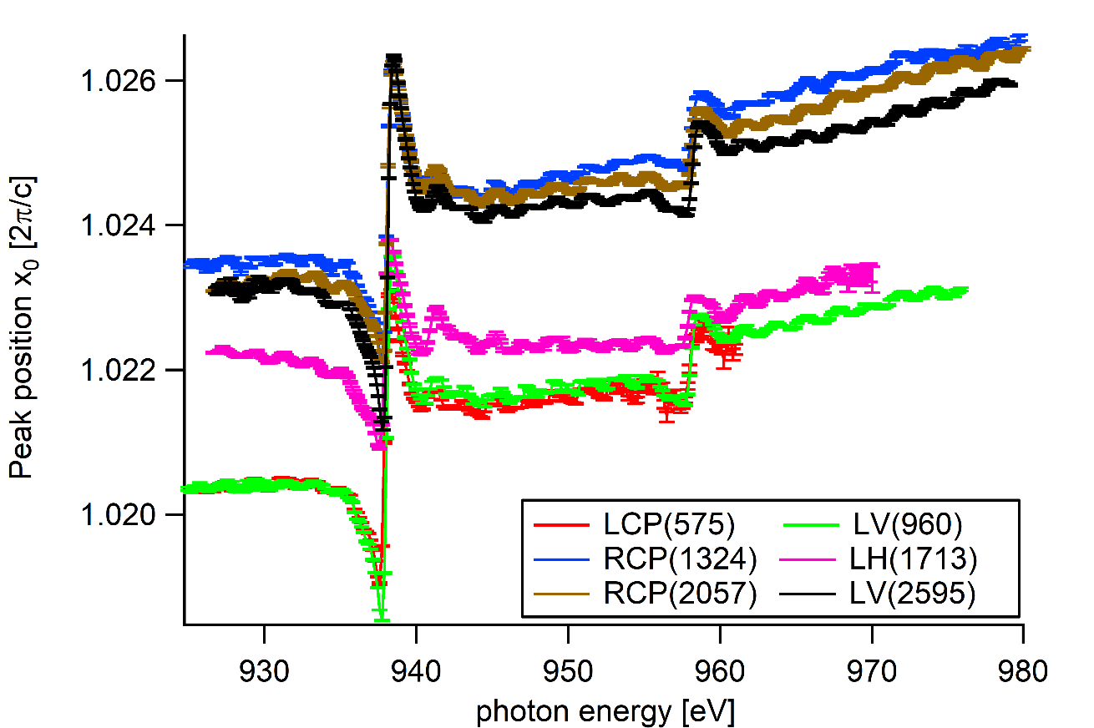
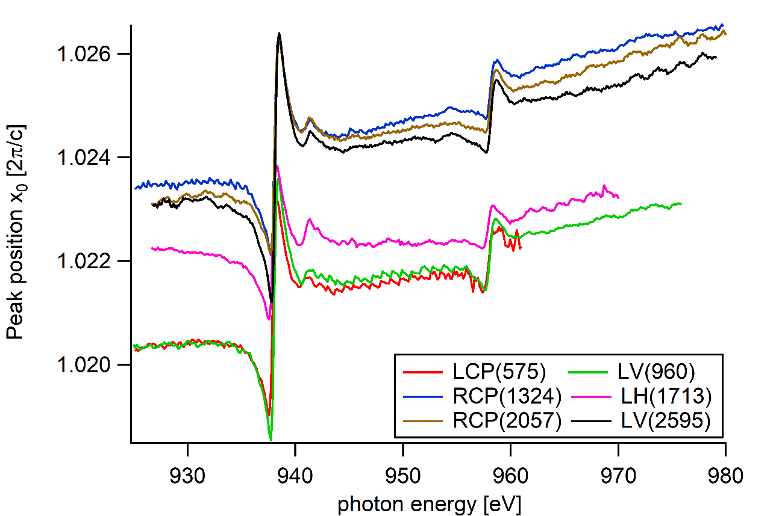
Results
The oscilating is still present in the data, but it decreased.

Slide 20
V. Exctracting physical quantities form the data
Complex refractive index
Something else

Slide 21
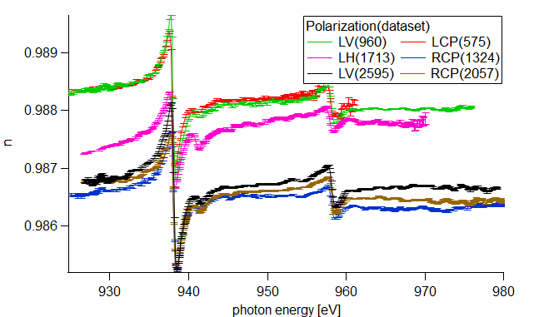
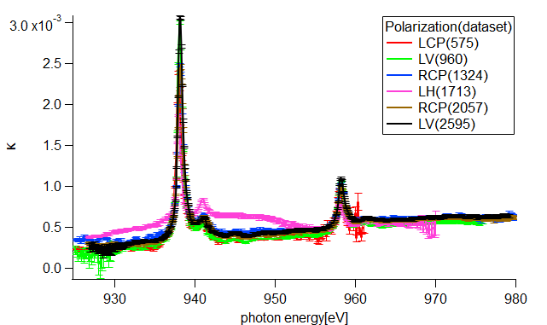
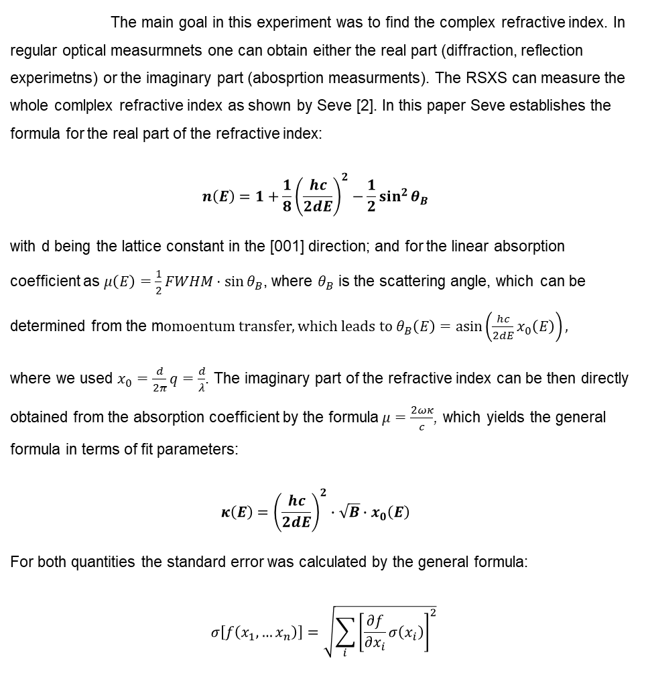
Complex refractive index
The main goal in this experiment was to find the complex refractive index. In regular optical measurmnets one can obtain either the real part (diffraction, reflection experimetns) or the imaginary part (abosprtion measurments). The RSXS can measure the whole comlplex refractive index as shown by Seve [2]. In this paper Seve establishes the formula for the real part of the refractive index:
$$n\left(E\right)=1+\frac{1}{8}{\left(\frac{hc}{2dE}\right)}^{2}−\frac{1}{2}\sin^{2}{θ_{B}}$$
with d being the lattice constant in the [001] direction; and for the linear absorption coefficient as $μ\left(E\right)=\frac{1}{2}FWHM⋅\sin{θ_{B}}$, where $θ_{B}$ is the scattering angle, which can be determined from the m$omoentum transfer,$which leads to $θ_{B}\left(E\right)=\operatorname{asin}\left(\frac{hc}{2dE}x_{0}\left(E\right)\right),$
where we used $x_{0}=\frac{d}{2π}q=\frac{d}{λ}$. The imaginary part of the refractive index can be then directly obtained from the absorption coefficient by the formula$μ=\frac{2ωκ}{c}$, which yields the general formula in terms of fit parameters:
$$κ\left(E\right)={\left(\frac{hc}{2dE}\right)}^{2}∙\sqrt{B}∙x_{0}\left(E\right)$$
For both quantities the standard error was calculated by the general formula:
$$σ\left[f\left(x_{1},…x_{n}\right)\right]=\sqrt{\sum_{i}{{\left[\frac{∂f}{∂x_{i}}σ\left(x_{i}\right)\right]}^{2}}}$$

Slide 22
Dielectric Tensor

Slide 23
VI. Kramers-Kronig Analysis
Regular Kramers-Kronig transform (KKT) and ist inverse (IKKT)
Extended KKT and IKKT
KKT for all polarizations
Conclusions

Slide 24
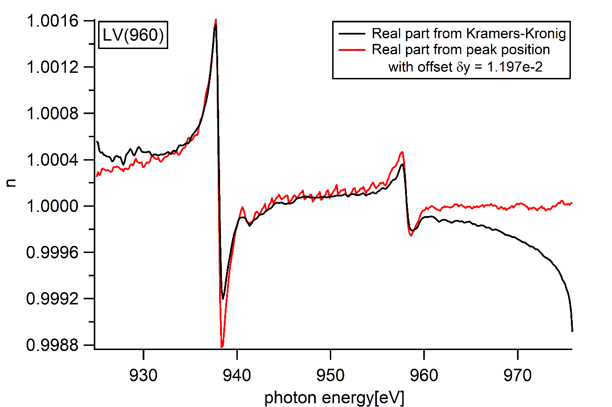
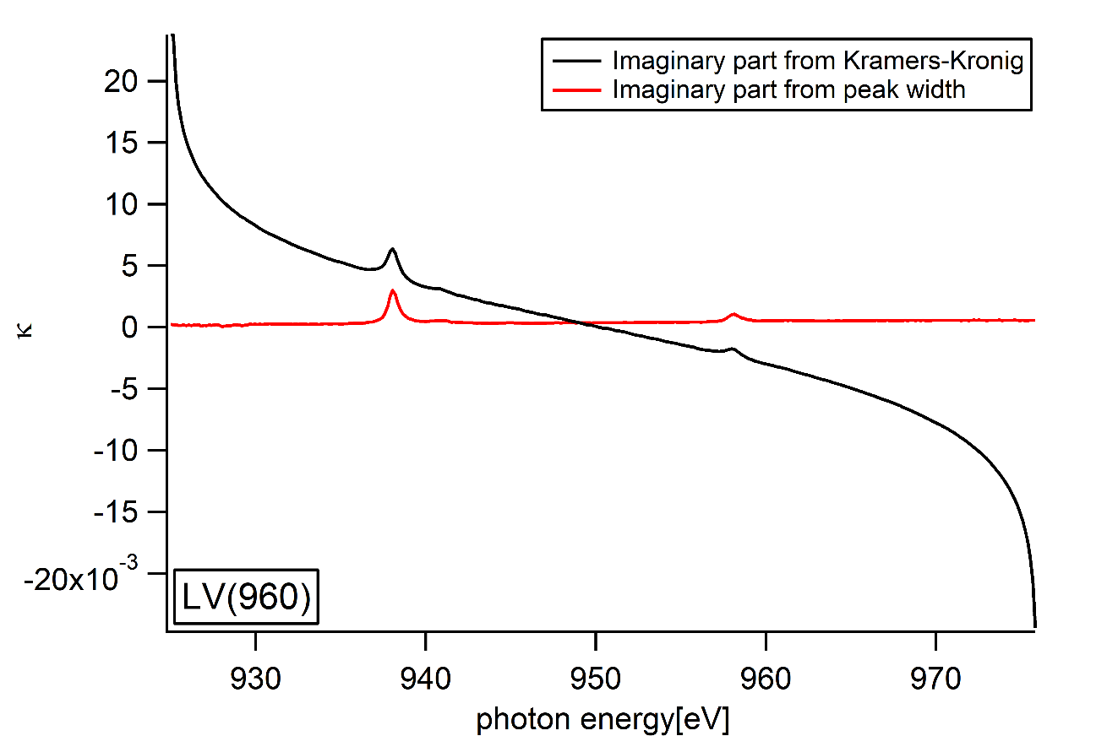
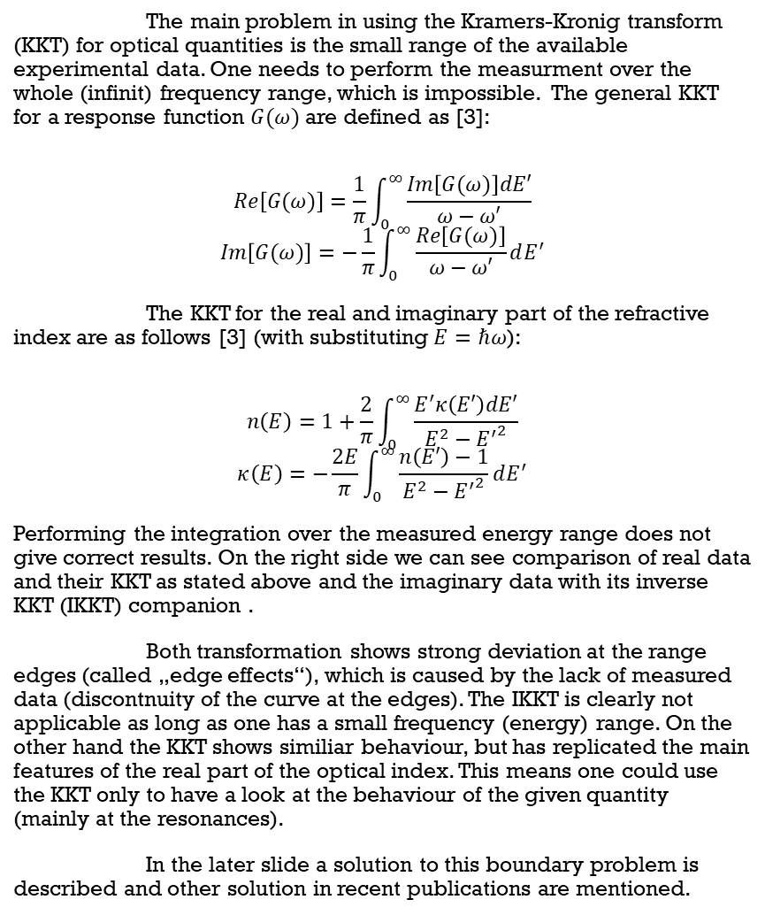
Regular kramers-kronig and ist inverse
The main problem in using the Kramers-Kronig transform (KKT) for optical quantities is the small range of the available experimental data. One needs to perform the measurment over the whole (infinit) frequency range, which is impossible. The general KKT for a response function $G(ω)$ are defined as [3]:
$$Re\left[G(ω)\right]=\frac{1}{π}\int_{0}^{∞}{\frac{Im\left[G(ω)\right]dE′}{ω−ω′}}$$
$$Im\left[G(ω)\right]=−\frac{1}{π}\int_{0}^{∞}{\frac{Re\left[G(ω)\right]}{ω−ω′}dE^{′}}$$
The KKT for the real and imaginary part of the refractive index are as follows [3] (with substituting $E=ℏω$):
$$n\left(E\right)=1+\frac{2}{π}\int_{0}^{∞}{\frac{E^{′}κ\left(E′\right)dE′}{E^{2}−{E^{′}}^{2}}}$$
$$κ\left(E\right)=−\frac{2E}{π}\int_{0}^{∞}{\frac{n\left(E′\right)−1}{E^{2}−{E^{′}}^{2}}dE^{′}}$$
Performing the integration over the measured energy range does not give correct results. On the right side we can see comparison of real data and their KKT as stated above and the imaginary data with its inverse KKT (IKKT) companion .
Both transformation shows strong deviation at the range edges (called „edge effects“), which is caused by the lack of measured data (discontnuity of the curve at the edges). The IKKT is clearly not applicable as long as one has a small frequency (energy) range. On the other hand the KKT shows similiar behaviour, but has replicated the main features of the real part of the optical index. This means one could use the KKT only to have a look at the behaviour of the given quantity (mainly at the resonances).
In the later slide a solution to this boundary problem is described and other solution in recent publications are mentioned.

Slide 25





Extended kkt and ikkt
The first solution (which is actually used in the analysis of the refractive index) is to fit the experimental data at the energy ranges and to extrapolate the data with the fit function with a continuity constraint of the data at the ends of the measurment range, mathematically defined as:
$$\lim_{E→E_{0}^{−}}{f_{extended}(E)}=\lim_{E→E_{0}^{+}}{f_{exp}(E)}$$
$$\lim_{E→E_{end}^{+}}{f_{extended}(E)}=\lim_{E→E_{end}^{−}}{f_{exp}(E)}$$
No assumption were made for the data at infinite frequency, only at the range boarders. The graphs on the right side show the fit procedure for the refractive index and the extrapolated data (the data is extrapolated to a larger energy range, but for presenting the extrapolating process it was cut to a smaller region).
This KKT extending scheme give reasonable results which are shown in the next slides. There exist other solutions to this problem, such as:
Using Fourier Transform analysis [4] - A relation for the Kramers-Kronig with the Fourier-Series coeffient is derived in this paper. Knowing those coefficients yields directly to the KK transformed curve. This method reduces the edge effect,m but didn‘t get rid of it.
Using a simple lorentzian curve beyond the measured region [5] - This methods is applicable for each resonance peak seperately, but for a broader spectrum of resonances it the KKT don‘t match the proper result. Moreover the backgound limits the posibility of a good fit

Slide 26


Influence of the extrapolation
Increasing number of extrapolated points reduces edge effect
At some points the spectrum is only obtaining an offset (which is decreasing with the no. pnts)

Slide 27



KKT via fourier transform
Extrapolation equivalent to the previous one
Deriving from fourier transform and convolution of 2 functions for $n_{c}\left(ω\right)=n\left(ω\right)+iκ(ω)$:
$n\left(ω\right)=1+\frac{1}{π}ℱ^{−1}\left[−iπℱ\left[κ\left(ω\right)\right]\left(t\right)\right]\left(ω\right)$
$κ\left(ω\right)=ℱ^{−1}\left[−\frac{1}{iπ}ℱ\left[π\left(n(ω\right)−1)\right]\left(t\right)\right]\left(ω\right)$
$Nln\left(N\right)$ operations, while previous KKT has $N^{2}$ operations
No singularities

Slide 28


KKT via fourier transform is almost identical to ordinary KKT (only constant offset)
For IKKT the fourier transform approach is much better (close to real value and is not set belowe zero)

Slide 29






Kkt for all polarizations
What we see in these graphs and the on in the later slide is the KKT and IKKT applied for the experimantal data for each polarization. For the KKT almost every dataset matches the experimental data (only a constant y-offset had to be applied). Although for LH polarization the KKT doesn‘t fit the experimental data.
In contrast the IKKT decreases with energy, which can be explained by the fact, that the refractive index lies below unity. In general the real part of the refracitve index should be in the large frequency limit equal to unity. This deviation of the refractive index is caused by the deviation in the peak position from unity.

Slide 30






Kkt for all polarizations

Slide 31
Conclusions
TO DO:
Stichpunkte, nicht text
Title, graph bigger
make comparison for IKKT if the energy range changes the edge effect

Slide 32
VII. Total Electron Yield
Raw data
Fitting background
Multipeak fit for finding resonances.
Resonance frequencies

Slide 33
Raw tey data

Slide 34


Fiting backgound
A common procedure in analyzing X-ray Absorption Spectra is to determine the background intensity assossiated with excitation of electrons into the continuum. One could use various methods to evaluate the background (which is very similiar to a step function). The upper graph shows 2 different ways to do so. One is using the Shirley algorithm and the other is using the arcus tangent function to fit into the background. Each gives reasonable results, but the first one is clearly fitting this feature.

Slide 35


Multipeak fit

Slide 36


Resonance Frequencies
edge | $$Cu^{2+} L_{3} edge$$ |  |  | $$Cu^{1+} L_{3} edge$$ |  |  | $$Cu^{2+} L_{2} edge$$ |  |  | $$Cu^{1+} L_{2} edge$$
Polarization | $$E_{0} [eV]$$ | $$FWHM [eV]$$ | $$ΔE_{0}$$ | $$E_{0} [eV]$$ | $$FWHM [eV]$$ | $$ΔE_{0}$$ | $$E_{0} [eV]$$ | $$FWHM [eV]$$ | $$ΔE_{0}$$ | $$E_{0} [eV]$$ | $$FWHM [eV]$$
LCP | 937.92 | 0.69799 | 2.98 | 940.90 | 1.047 | 17.06 | 957.96 | 1.033 | - | - | -
LV(960) | 938.05 | 0.70837 | 3.03 | 941.08 | 0.93292 | 16.98 | 958.06 | 1.0434 | 3.12 | 961.18 | 0.98713
RCP(1324) | 938.11 | 0.7116 | 3.01 | 941.12 | 1.0446 | 17.00 | 958.12 | 1.0286 | 3.08 | 961.20 | 1.2238
LH | 937.94 | 0.76062 | 2.99 | 940.93 | 0.97119 | 17.14 | 958.07 | 1.2016 | - | - | -
RCP(2057) | 938.15 | 0.80463 | 2.90 | 941.05 | 1.102 | 17.10 | 958.15 | 1.0462 | 3.00 | 961.15 | 0.85475
LV(2595) | 938.17 | 0.70723 | 2.99 | 941.16 | 1.0607 | 17.05 | 958.21 | 1.0194 | 3.22 | 961.43 | 1.5048

Slide 37
VIII. Magnetic Dichroism
Circular Magnetic Dichroism
Linear Magnetic Dichroism
Magnetic Ordering: proper guess

Slide 38




Circular Magnetic X-ray Dichroism (CMXD)
From TEY
From Imaginary part of refractive index

Slide 39




Lircular Magnetic X-ray Dichroism (LMXD)
From TEY
From Imaginary part of refractive index

Slide 40
Magnetic Ordering
Strong circular dichroic effects suggest rather ferromagnetic ordering
Linear dichroic effecct result from the lattice structure (tetragonal symmetry)
The investigated material is a cuprate, thus it is a spin-half system and in the most cases exhibits antiferromagnetic ordering

Slide 41

Optical Conductivity
The measurment of X-ray absorption intensities is giving vaious application in analyzing magnetic materials. According to haverkord [3] one could extract the conductivity tensor knowing the absorption for different polarizations. For a magnetic material one needs to determine the off-diagonal elements of the tensor, which can be done using circular polarized light. Among the transition metals, copper (Cu), is a common spin-1/2 systems. That means we can neglect bimagnon excitation (which ar typically very weak) and write the conductivity tensor in the form:
$$\overset{⃡}{σ}=\left(\begin{matrix}σ_{a_{1g}^{B}}^{\left(0\right)} & 2S_{z}σ_{a_{2u}^{ }}^{\left(1\right)} & −2S_{y}σ_{e_{u}^{ }}^{\left(1\right)} \\ −2S_{z}σ_{a_{2u}^{ }}^{\left(1\right)} & σ_{a_{1g}^{B}}^{\left(0\right)} & 2S_{x}σ_{e_{u}^{ }}^{\left(1\right)} \\ 2S_{y}σ_{e_{u}^{ }}^{\left(1\right)} & −2S_{x}σ_{e_{u}^{ }}^{\left(1\right)} & σ_{a_{1g}^{A}}^{\left(0\right)}\end{matrix}\right) (1)$$
Neglecting self-absorption effects the absorption from XAS is directly proportional to the conductivity tensor:
$$I_{TEY}=−ℐm\left(ε^{∗}∙\overset{⃡}{σ}∙ε\right)$$
Using these two relations one can evaluate each of the tensor elements in (1)
This method yield only the imaginary part of the diagonal elements and the real part of the off-diagonal elements. As these are spectra function (in general response functions) one can use the KKT to get the imaginary/real companion.

Slide 42

Optical Conductivity

Slide 43
Reference
[1] „Data reduction and error analysis for the physical science“, P.R. Bevington, D.K.Robinson
[2] „Determination of the Anomalous Scattering Factors in the Soft-X-ray Range using Diffraction from a Multilayer”, L. Seve, J. M. Tonnerre and D. Raoux
[3] „Kramers–Kronig Relations in Optical Materials Research”, V. Lucarini, J.J. Saarinen, K.-E. Peiponen, E.M. Vartiainen
[4] ”A Fourier series method for numerical Kramers-Kronig analysis“, D. W. Johnson
[5] „ Numerical Evaluation of Kramers-Kronig Relations“, C. A. Emeis, L. J. Oosterhoff and Gonda de Vries
[6] „X-ray Circular Dichroism as a Probe of Orbital Magnetization“, B-T. Thole, Paolo Carra, F. Sette and G. van der Laan
[7] „Theory of Resonant Inelastic X-Ray Scattering by Collective Magnetic Excitations”, M.W. Haverkort
[8] „Analytic continuation, singular-value expansions, and Kramers–Kronig analysis“, A Dienstfrey and L Greengard

Slide 44






RSXS result

